Slide 1



Introduction to the Project
Library Management System Using Java Swing & MySQL
Project Overview
This project implements a complete digital library management system to handle library operations such as cataloging, issuing, and tracking books.
Platform & Tools
Developed using Java Swing for the GUI, MySQL for backend database, and IntelliJ IDEA as the development environment.
Target Users
Designed for librarians, administrative staff, and students or members to interact with and manage resources efficiently.
Notes:
Welcome to the introduction of our Library Management System project. In this system, we digitize the entire library workflow, offering a smooth interface to manage book inventories, issue and return logs, and member records. The project bridges traditional library operations with modern digital infrastructure.
Java Swing serves as the backbone of the graphical user interface, ensuring responsive and intuitive interactions, while MySQL provides a robust data management backend. We developed the entire system within IntelliJ IDEA, leveraging its powerful Java development tools for a seamless coding experience.
This solution is tailored for librarians who handle book inventories, administrative staff managing records, and members who want quick access to book information. It aims to streamline operations and improve the user experience for all stakeholders involved.

Slide 2

Objectives of the System
Defining the Purpose and Scope
Automation of Library Operations: Replace manual processes with a digital system to improve efficiency, reduce errors, and streamline workflows.
Real-Time Data Access: Enable instant access to updated book and member information for better decision-making and resource management.
Enhanced User Experience: Provide a user-friendly interface for all user roles including admin, staff, and members.
Photo by Markus Winkler on Unsplash
Notes:
The primary aim of this system is to automate and digitize core library functions. By doing so, it significantly reduces the need for manual input, which not only minimizes human error but also increases the speed and efficiency of operations.
With this system, users can access real-time data, whether it's about the availability of a book or the status of a member’s issued items. This facilitates better and faster decision-making, particularly useful in busy or academic library settings.
Finally, the design goal was to create a user-centric interface that is intuitive for both staff and students. Usability was prioritized to ensure that users from all backgrounds can interact with the system effectively, leading to higher adoption and satisfaction.

Slide 3

Technologies Used
Frameworks and Tools for Development
Java Swing: Used for building the graphical user interface (GUI), offering a rich set of components and event-driven programming model.
MySQL Database: Relational database used for storing book records, member details, transactions, and more.
IntelliJ IDEA: An integrated development environment (IDE) that supports Java development with advanced features and debugging tools.
Photo by Aleks Dorohovich on Unsplash
Notes:
Let’s explore the core technologies that make up this Library Management System. Java Swing is the primary framework for the user interface. It allows for the creation of responsive and intuitive GUIs that provide a desktop-like experience for users.
All backend data is managed through MySQL, a powerful open-source relational database. It ensures data integrity, enables complex queries, and supports scalability as the library grows.
Development was conducted using IntelliJ IDEA. It’s a modern IDE that supports advanced coding features, real-time error detection, and easy integration with version control systems, which streamlined the development and debugging processes significantly.

Slide 4



Technologies Used
Frameworks and Tools for Development
Java Swing
Java's GUI toolkit for creating desktop applications; supports components like buttons, tables, and dialogs.
MySQL
Robust relational database system used to store and manage the entire library dataset efficiently.
IntelliJ IDEA
Advanced IDE used for Java development, providing intelligent code completion and powerful debugging.
Notes:
This slide highlights the three core technologies that form the backbone of our system. Java Swing is the technology behind the rich, interactive user interface. It allows us to build a visually cohesive and responsive application that enhances user experience.
For data management, we rely on MySQL – an open-source, high-performance relational database system. It supports complex queries and handles large volumes of data reliably, ensuring scalability and performance.
All development was conducted within IntelliJ IDEA, an industry-leading IDE that speeds up coding with features like smart code assistance, version control integration, and an intuitive UI that enhances developer productivity.

Slide 5
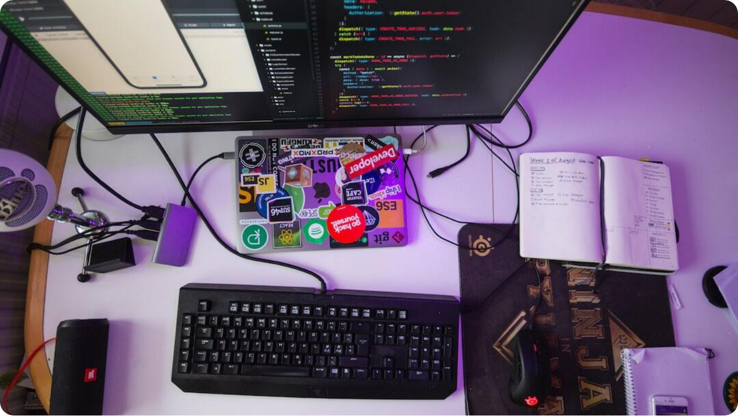
Library Management System
Built using Java Swing, MySQL & IntelliJ IDEA
Technology Stack: Java Swing for GUI, MySQL for backend, IntelliJ IDEA for development
End-to-End Solution: Manages book lending, inventory, users, and overdue tracking
Professional Implementation: Built with scalable architecture and intuitive interface
Photo by Oskar Yildiz on Unsplash
Notes:
Welcome to this professional presentation on the Library Management System designed using Java Swing, MySQL, and IntelliJ IDEA. This system is a comprehensive digital solution to manage the operations of a library, from tracking books and users to managing fines and inventory.
The technologies used are robust and industry-standard. Java Swing allows us to create a responsive desktop interface, while MySQL provides a reliable and scalable database. IntelliJ IDEA, a leading development environment, empowers efficient coding and debugging. This system is tailored for educational institutions or small libraries seeking to automate their operations.
In this presentation, we’ll walk through the architecture, features, challenges, and potential future enhancements of the system. Let’s dive in!

Slide 6


Overview of the Library Management System
Core Functions and System Goals
Automated Book Management
Tracks acquisition, lending, return, and availability of books
User Role Segregation
Distinct functionalities for admins, librarians, and members
Fine and Notification System
Notifies users of due dates and calculates overdue fines
Notes:
This Library Management System is engineered to streamline every core function of a traditional library through digitization. The core objectives are not just to make operations faster, but to ensure reliability and user-specific accessibility.
The system allows for seamless tracking of books from acquisition through lending to returns. Each book’s status is automatically updated, significantly reducing manual errors and administrative overhead. Distinct user roles such as administrator, librarian, and member ensure that actions are permissioned and secure.
Integrated notifications and fine calculations keep users informed and accountable, making the system user-centric and operationally efficient. Let’s now explore the technologies that enable these features.

Slide 7
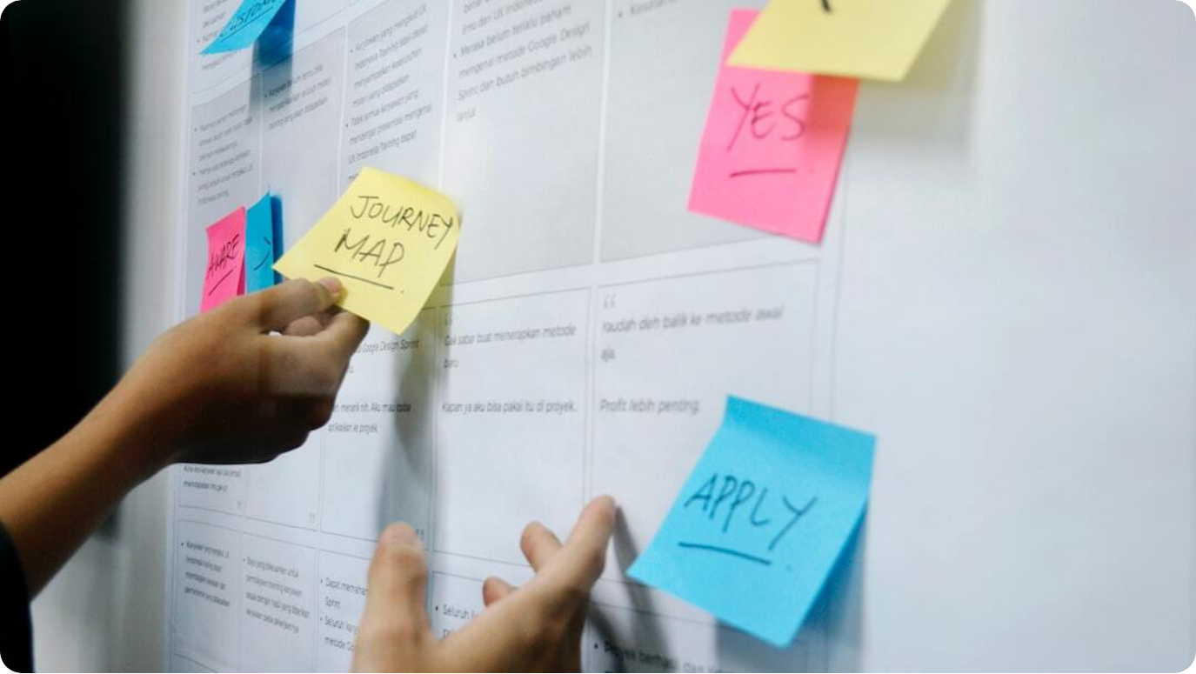
Purpose and Scope of the Project
Why and How the Library Management System Was Built
Problem Identification: Manual systems cause inefficiency and errors in library operations
Project Goals: Automate cataloging, lending, and user interactions with the library
Target Users: Designed for educational institutions, public libraries, and private organizations
Photo by UX Indonesia on Unsplash
Notes:
The development of this Library Management System stemmed from a clear need to overcome inefficiencies in traditional manual library operations. Managing hundreds or thousands of books manually often results in errors, loss of information, and significant time overhead.
The primary goal was to design an automated system that can handle all key functions like cataloging, issuing, returning, and fine calculation—while also offering user-friendly access for various user roles. It significantly improves operational efficiency, accuracy, and access to resources.
This system is aimed at institutions such as schools, colleges, public libraries, and private firms managing resource libraries. It is modular and scalable, allowing for customization based on the institution’s size and specific requirements.

Slide 8
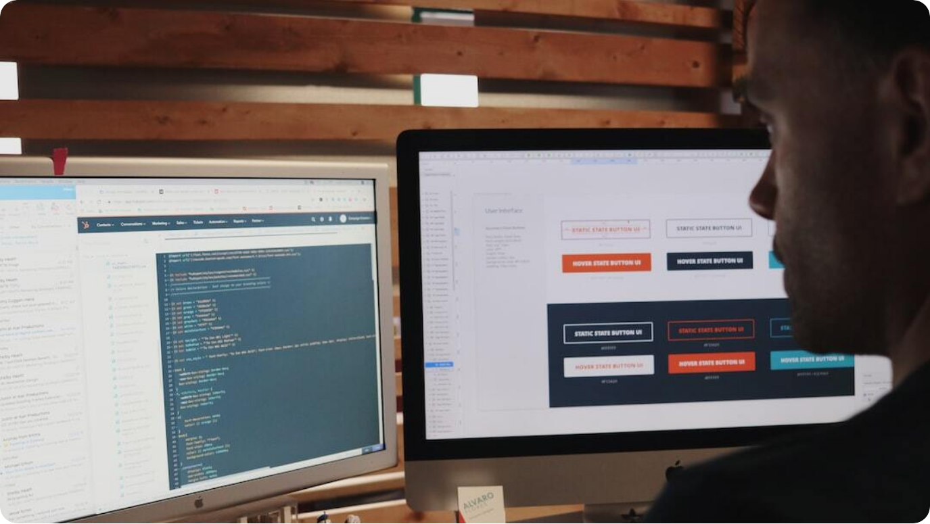
Introduction to Java Swing
Building Rich GUI Applications in Java
Lightweight GUI Toolkit: Swing is a part of Java Foundation Classes for creating window-based applications
Highly Customizable: Allows full control over UI components and layout management
Cross-Platform Compatibility: Runs seamlessly across platforms due to Java Virtual Machine (JVM)
Photo by Campaign Creators on Unsplash
Notes:
Java Swing is a graphical user interface toolkit that forms part of the Java Foundation Classes (JFC). It’s used to build window-based applications and provides a rich set of GUI components like buttons, text fields, and tables.
One of its core strengths lies in its flexibility and customizability. Developers can manipulate layouts, styles, and component behaviors to create tailored user interfaces. This allows for the creation of polished, intuitive desktop applications.
Its integration with the Java platform means applications developed using Swing are platform-independent. This cross-platform functionality ensures a consistent user experience across different operating systems, making it ideal for enterprise and institutional software.

Slide 9


MySQL Database Integration
Backend Support for Data Storage and Retrieval
Relational Database Model
Stores data in tables with defined relationships, ideal for structured data
Secure and Scalable
Provides robust data protection, indexing, and scalability
SQL Query Support
Facilitates data manipulation using SQL for precision and control
Notes:
MySQL serves as the backbone of this library management system by providing structured data storage and retrieval capabilities. As a relational database management system (RDBMS), MySQL efficiently organizes data in tables with clear relationships between them, which is perfect for library datasets.
Its scalability and robust security mechanisms ensure that sensitive user and inventory data remain protected, even as the system scales to accommodate hundreds or thousands of entries.
Moreover, MySQL supports the full suite of SQL commands, which allows precise data manipulation. This enables features like complex search filters, real-time updates, and consistent data integrity across the application.

Slide 10
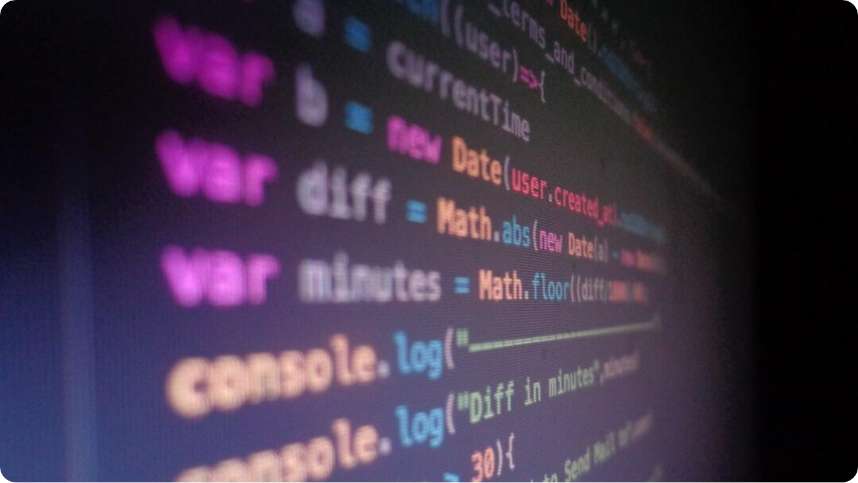
Why IntelliJ IDEA?
Optimizing Development with Powerful IDE Features
Smart Code Assistance: Advanced features like code completion, refactoring, and inspections
Integrated Tools: Built-in support for version control, database tools, and testing
Efficient UI Design: Supports GUI builders and seamless integration with Swing components
Photo by apoorv mittal on Unsplash
Notes:
IntelliJ IDEA is a premier Integrated Development Environment (IDE) developed by JetBrains. It significantly enhances the developer experience with its intelligent code assistance and ergonomic design.
For this Library Management System, IntelliJ IDEA accelerates development through smart features like real-time error detection, auto-completion, and intelligent refactoring tools. These allow for writing cleaner, more maintainable code.
It also integrates essential tools like Git, Maven, and database connectors within the IDE itself. Additionally, it provides robust support for Java Swing applications, including visual GUI builders, making it an ideal environment for both backend logic and user interface development.

Slide 11
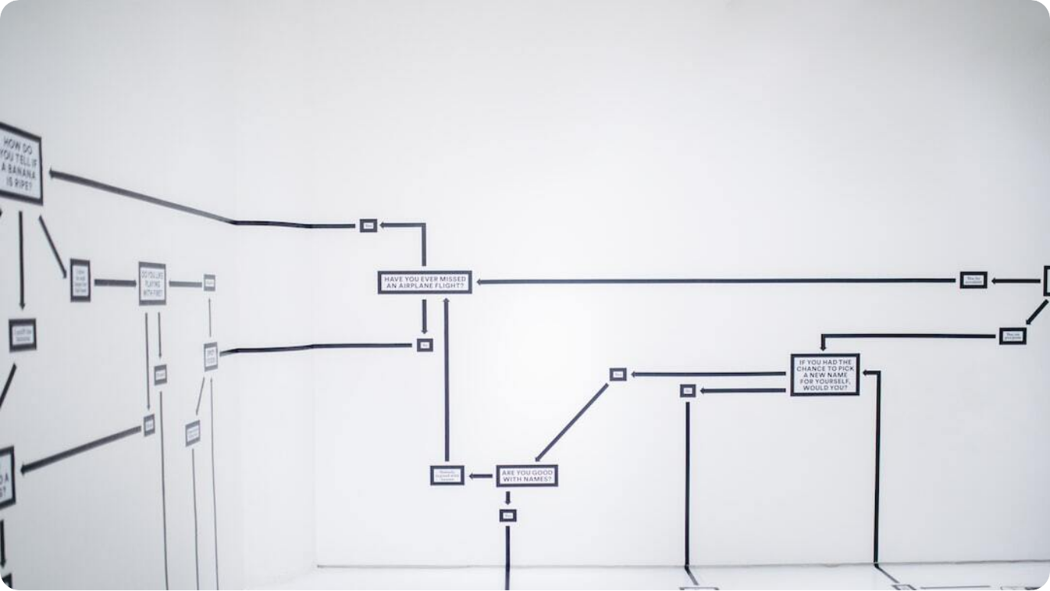
System Architecture Diagram
Component-Level Structure of the Application
Three-Tier Architecture: Composed of Presentation (GUI), Logic (Java), and Data (MySQL) layers
Modular Design: Each module handles distinct responsibilities to promote scalability
Client-Server Communication: Java application interacts with MySQL over JDBC
Photo by Hanna Morris on Unsplash
Notes:
The Library Management System follows a robust three-tier architecture. This architectural model separates the application into the Presentation Layer, the Logic Layer, and the Data Layer.
The Presentation Layer is constructed using Java Swing to ensure a rich user interface. Business logic resides in the core Java classes, ensuring modular and maintainable code. The backend uses MySQL for secure, structured data storage and retrieval, accessed via Java Database Connectivity (JDBC).
This separation of concerns enhances maintainability, allows parallel development, and ensures each component can evolve independently. The architecture supports expansion and adaptation, critical for enterprise-grade applications.

Slide 12
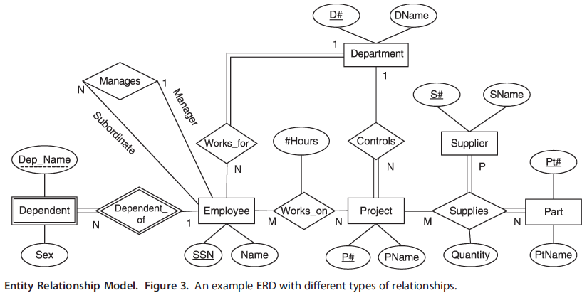
Entity-Relationship (ER) Diagram
Logical Data Model of the Library System
Key Entities: Includes Books, Users, Loans, and Admins as primary tables
Defined Relationships: One-to-many relationships between users and loans, books and loans
Normalization: Data is normalized to reduce redundancy and improve integrity
Photo by Hanna Morris on Unsplash
Notes:
The ER diagram defines the logical structure of the database underlying the Library Management System. It maps out the relationships between various entities crucial to system operations.
The primary entities include Books, Users, Loans, and Admins. Each user can borrow multiple books, and each loan references both a user and a book. These relationships are crucial for data tracking and reporting functionalities.
Normalization is applied to ensure minimal redundancy and maintain data integrity. This foundational model supports efficient querying and lays the groundwork for the system’s database schema.

Slide 13



UML Class Diagram
Object-Oriented Blueprint of the Library System
Core Classes Defined
Includes Book, User, Admin, Loan, and Catalog classes
Encapsulation & Inheritance
Implements object-oriented principles for reusability and clarity
Class Relationships
Associations show object interaction and responsibilities
Notes:
The UML Class Diagram is a foundational component in designing object-oriented systems. In this Library Management System, the core classes include Book, User, Admin, Loan, and Catalog. These encapsulate the primary behaviors and properties of the entities.
Object-oriented principles such as encapsulation and inheritance are applied to promote modularity and reduce redundancy. For instance, both Admin and User can inherit from a common Person superclass, encapsulating shared attributes.
Associations among these classes clarify system responsibilities and interactions. This diagram forms the basis for implementation, ensuring a structured and coherent design strategy.

Slide 14
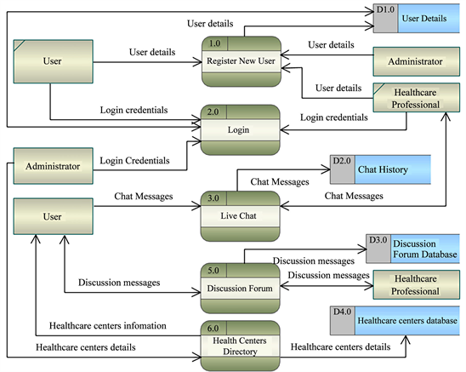
Data Flow Diagram (DFD)
System Interaction and Data Processing Flow
Process Identification: Visualizes how data flows through key processes: issue, return, inventory update
External Entities: Users and Admins interact through GUI, initiating data exchanges
Data Stores: Books, Users, and Transactions tables serve as persistent data repositories
Photo by Hanna Morris on Unsplash
Notes:
The Data Flow Diagram (DFD) presents a high-level overview of how information moves within the Library Management System. It helps stakeholders visualize the input, process, and output flows.
Key processes such as book issuing, returning, and inventory updates are illustrated to show their data dependencies. External entities like users and admins initiate actions through the graphical interface, which then interact with the core logic layer.
Data stores such as Books, Users, and Transactions are essential repositories. They ensure that every action is recorded and retrievable, enabling accurate system behavior and auditability.

Slide 15



User Authentication & Roles
Secure Access and Role-Specific Functionality
Login System
Validates user identity using credentials to prevent unauthorized access
Role-Based Access Control (RBAC)
Differentiates permissions for Admins, Librarians, and Members
Session Management
Ensures secure and persistent access during interactions
Notes:
Secure authentication is critical for any system managing sensitive and dynamic data. The Library Management System implements a structured login process that validates users through unique credentials.
Once authenticated, users are granted role-specific access via a Role-Based Access Control (RBAC) model. This ensures that admins can manage users and inventory, librarians can handle daily transactions, and members can access their borrowing history and catalog searches.
Session management further strengthens security by maintaining persistent but protected access throughout user interaction. This prevents session hijacking and enforces logout after inactivity, upholding the system’s integrity.

Slide 16

Conclusion & Key Takeaways
Summarizing Project Outcomes and Learnings
Efficient System Design: Java Swing + MySQL enables seamless and responsive user interaction
Security and Usability: RBAC and session management ensure secure, role-specific operations
Scalability: Architecture supports easy expansion and customization for broader use
Photo by Slidebean on Unsplash
Notes:
To conclude, this Library Management System is a testament to how well-integrated technology can elevate traditional processes. With Java Swing for GUI development and MySQL for robust backend management, the system handles both user experience and data integrity gracefully.
We emphasized secure authentication mechanisms and role-based access to protect user data and streamline operations. Furthermore, the modular and scalable architecture ensures that the system can be extended or adapted to meet diverse institutional needs.
The project showcases both technical execution and user-centered design—key traits for any successful software solution.

Slide 17



Thank You
Questions & Discussion Welcome
Presentation Complete
We’ve explored the design, features, and implementation of a complete LMS
Interactive Q&A
Please share your questions, suggestions, or feedback
Gratitude
Thank you for your attention and engagement!
Notes:
Thank you for your time and attention throughout this in-depth presentation of the Library Management System. We’ve covered the technical stack, system architecture, core features, and security principles that underpin this robust application.
I now open the floor to any questions or feedback you might have. Whether it's about the system design, implementation challenges, or future improvements—your insights are welcome and valued.
On behalf of the entire team behind this project, we appreciate your interest and look forward to continuing the discussion.

